Slide 1

GoFish!: A Tension Regulation Fishing Robot
TEAM 17
Nathan Ge, Chaoyi Hu, Julie Nguyen, Xiang Zhou

Slide 2
Overview

Slide 3

Project Overview & Motivation
Project Goal
Develop a 1-DOF rigid robotic fishing rod
Simulate fish-fighting interaction under controlled testing
Develop a control paradigm to regulate fishing-line tension near a 3.5 N target with a ±0.1 N deadband.
Motivation / Literature
Prior fishing haptic devices show that force feedback improves realism in fishing simulation.
Fishing-rod haptic displays have also been studied for presenting force sensation through a rod-and-line structure.
Applications
Fishing training simulator
Entertainment / interactive game controller
Robotics force-feedback education
System Concept

Slide 4
Hardware

Slide 5
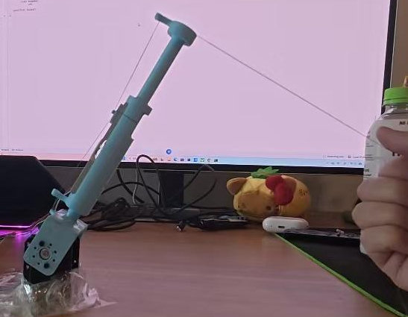
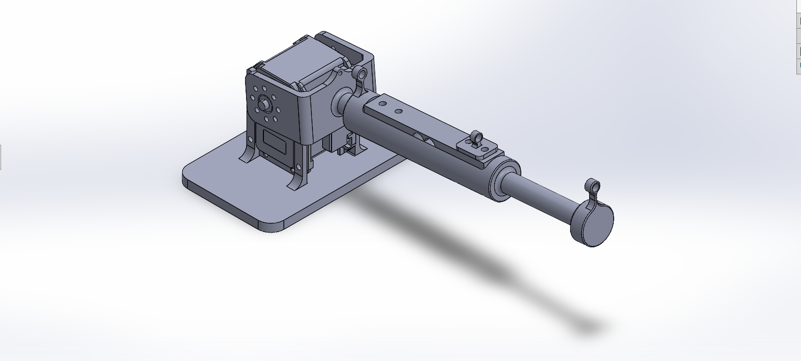
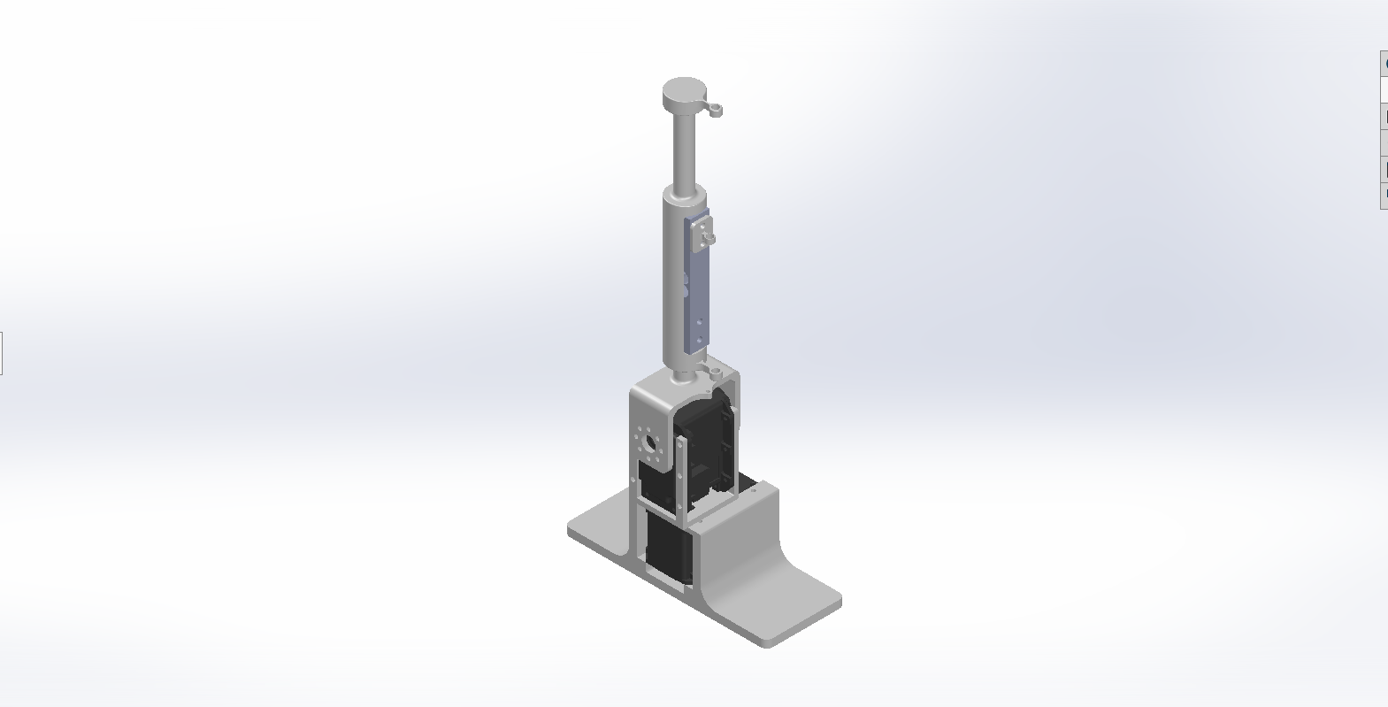
Hardware Test
1DOF
2DOF

Slide 6
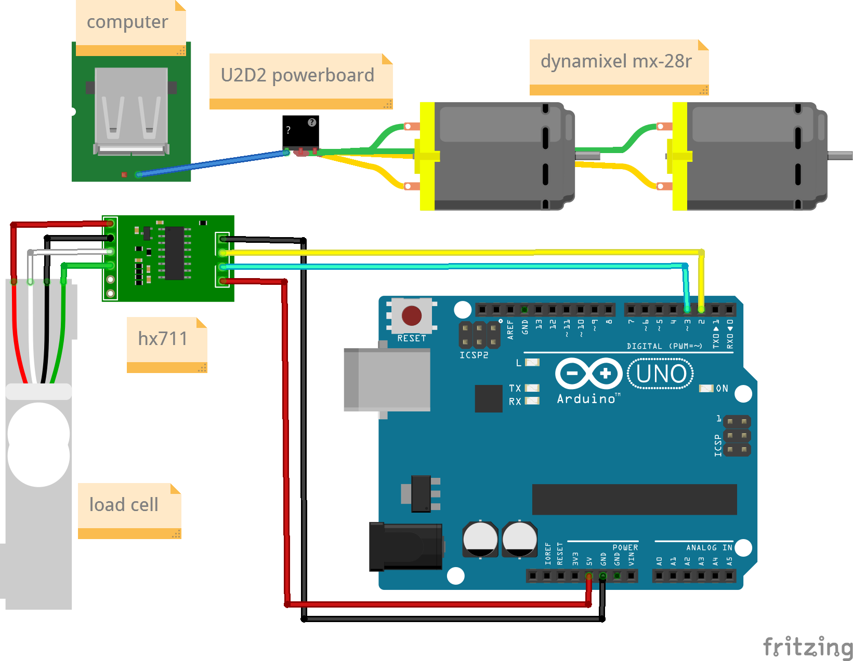
Wiring Diagram

Slide 7
Software

Slide 8
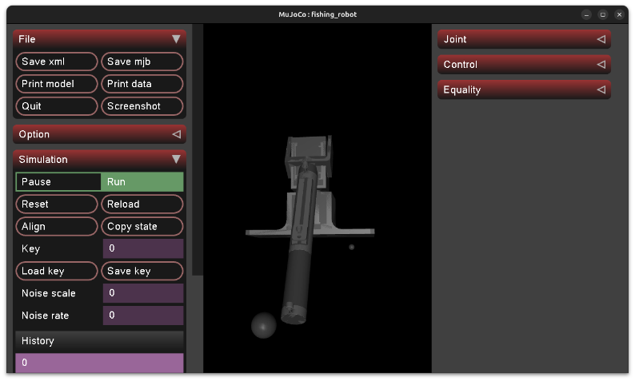
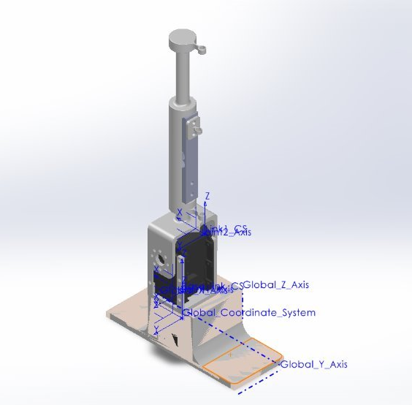
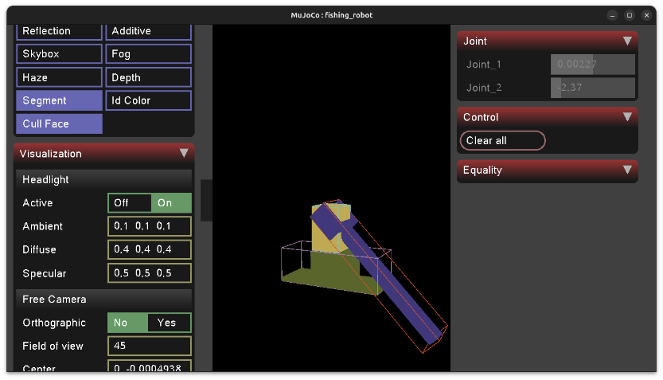
Simulation (mujoco)

Slide 9
Codebase (true implementation)
ROS2 - software architecture modularity
Building out the ROS2 codebase such that the control logic interacts seamlessly with Mujoco simulation and hardware control​
Bringup: launch configuration. Can launch simulation or hardware control based on preference​
Description: mesh and model descriptors​
Control: tension control package​
Planning: will likely be used to control randomness of 'fish' behavior. Can be thought of as a fish agent (our disturbance)​
Sensors: sensor readings and publishing​
Interfaces: develop protocol for inter-node communication​
Notes:
unfortunately we had to default back to our simpler mujoco simulation and hardware control pipeline
given software development complexities associated with ros2

Slide 10
Controller & Simulation

Slide 11
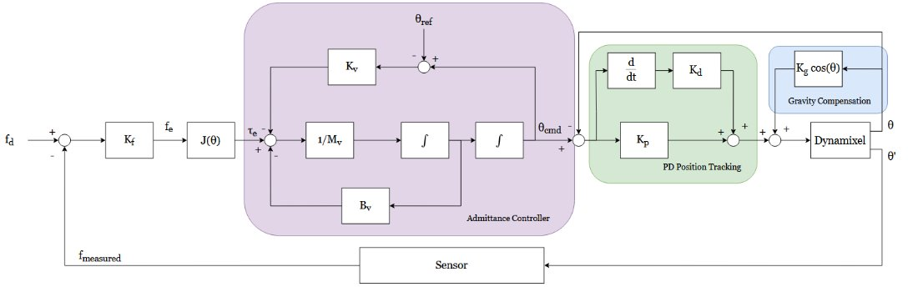
Controller Diagram (Admittance Control)
M_{v​} θ¨_{cmd}​+B_{v}​ θ˙_{cmd}​+K_{v}​(θ_{cmd}​−θ_{ref}​) = −J(θ) K_{f​}(f_{d}​−f_{measured}​)

Slide 12
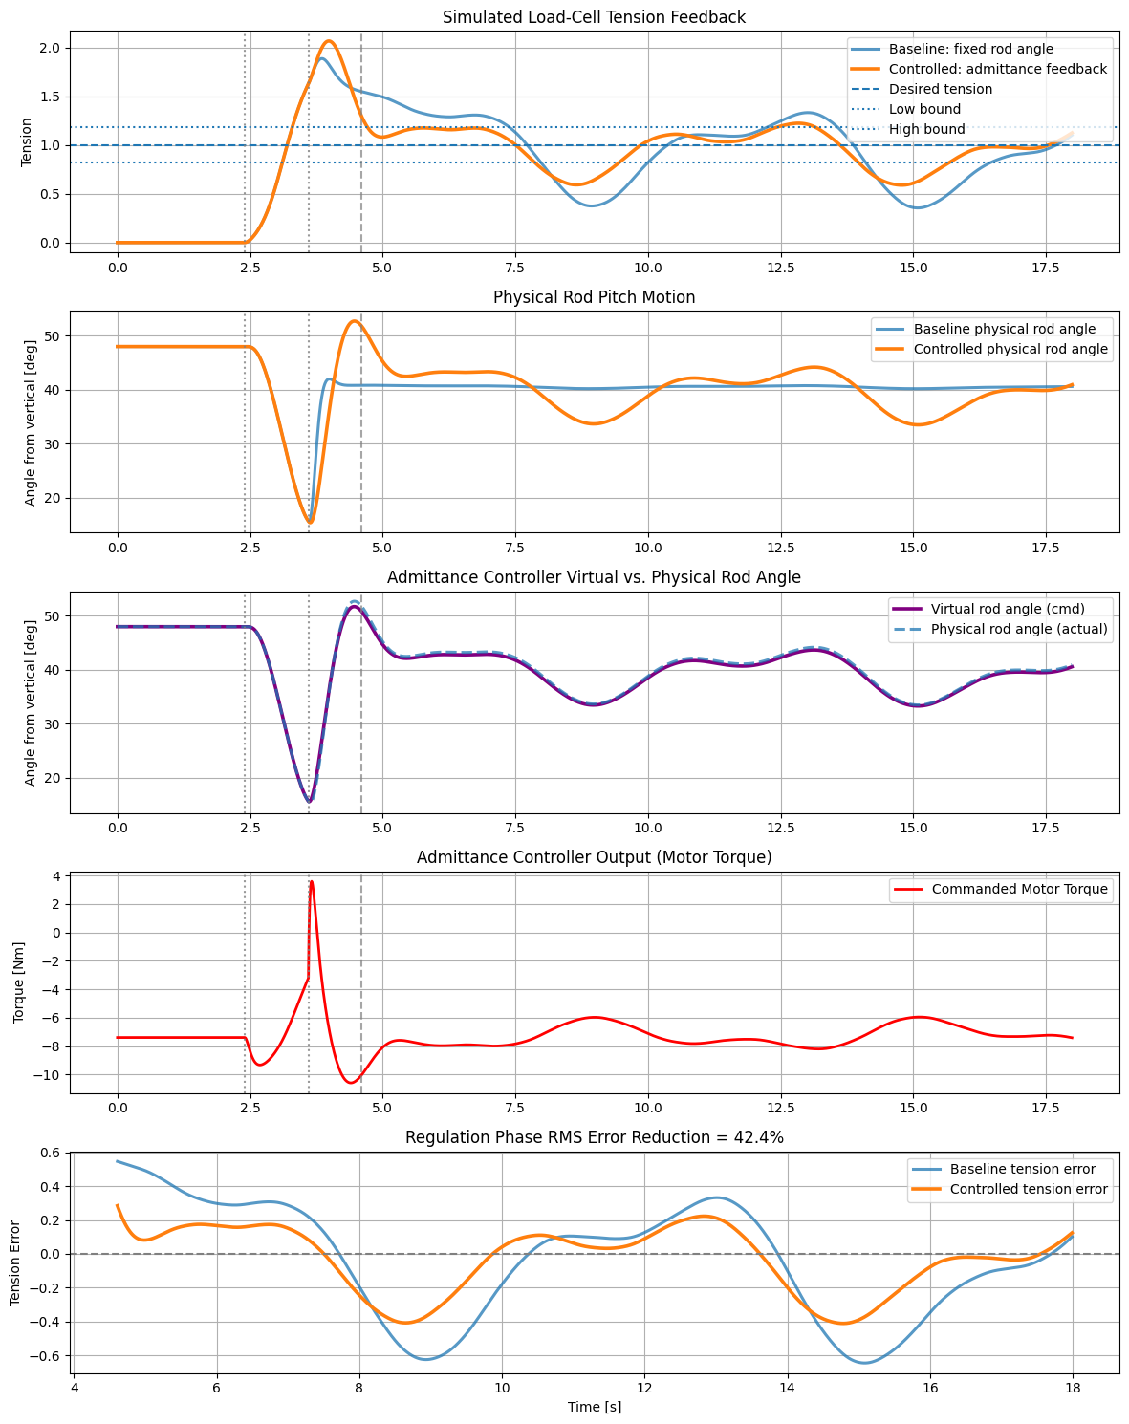
Admittance Controller Results

Slide 13
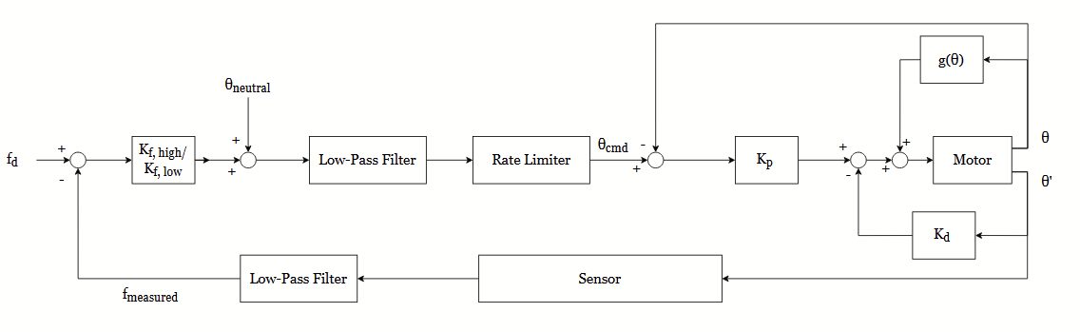
Controller Diagram (Proportional Force Control)
K_{f, low/high​}(f_{d}​−f_{measured}​) + θ_{neutral}= θ_{cmd}

Slide 14
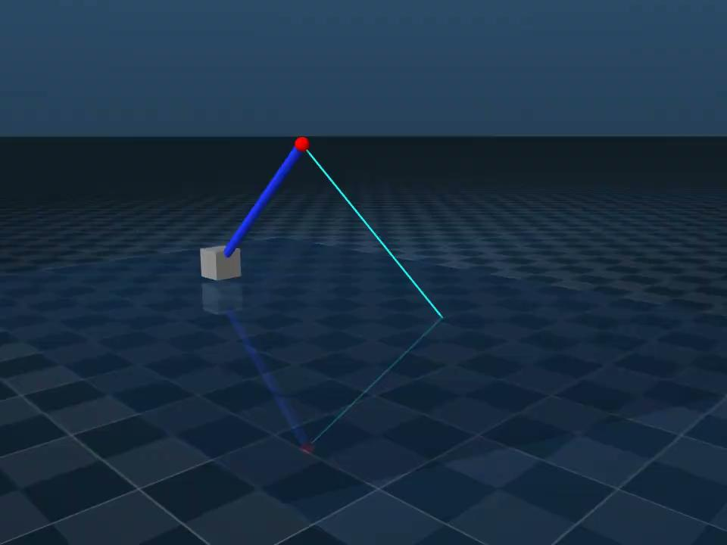
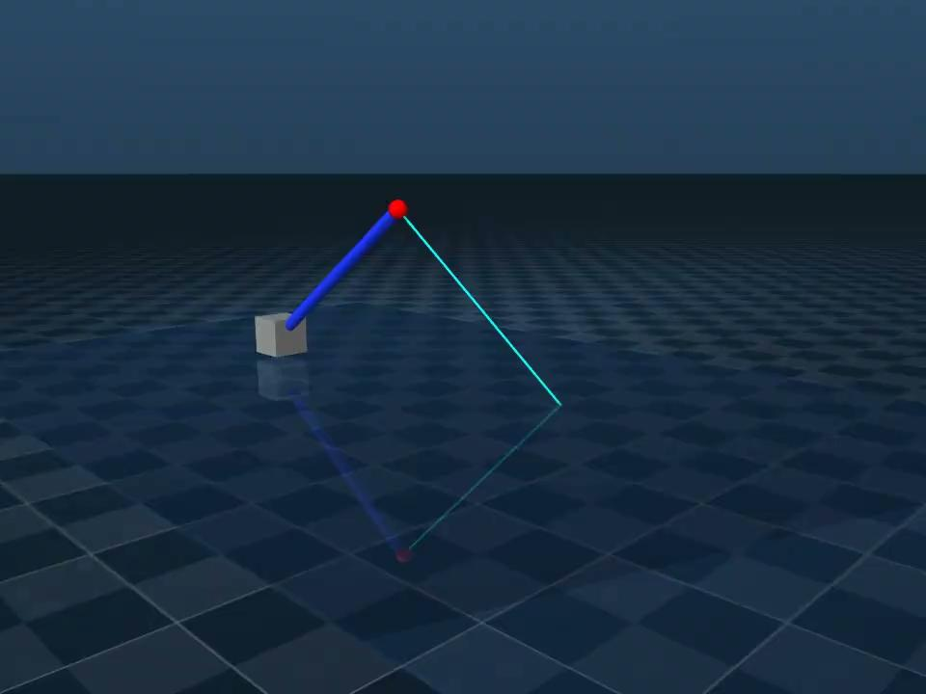
Admittance Controller
Force Controller

Slide 15
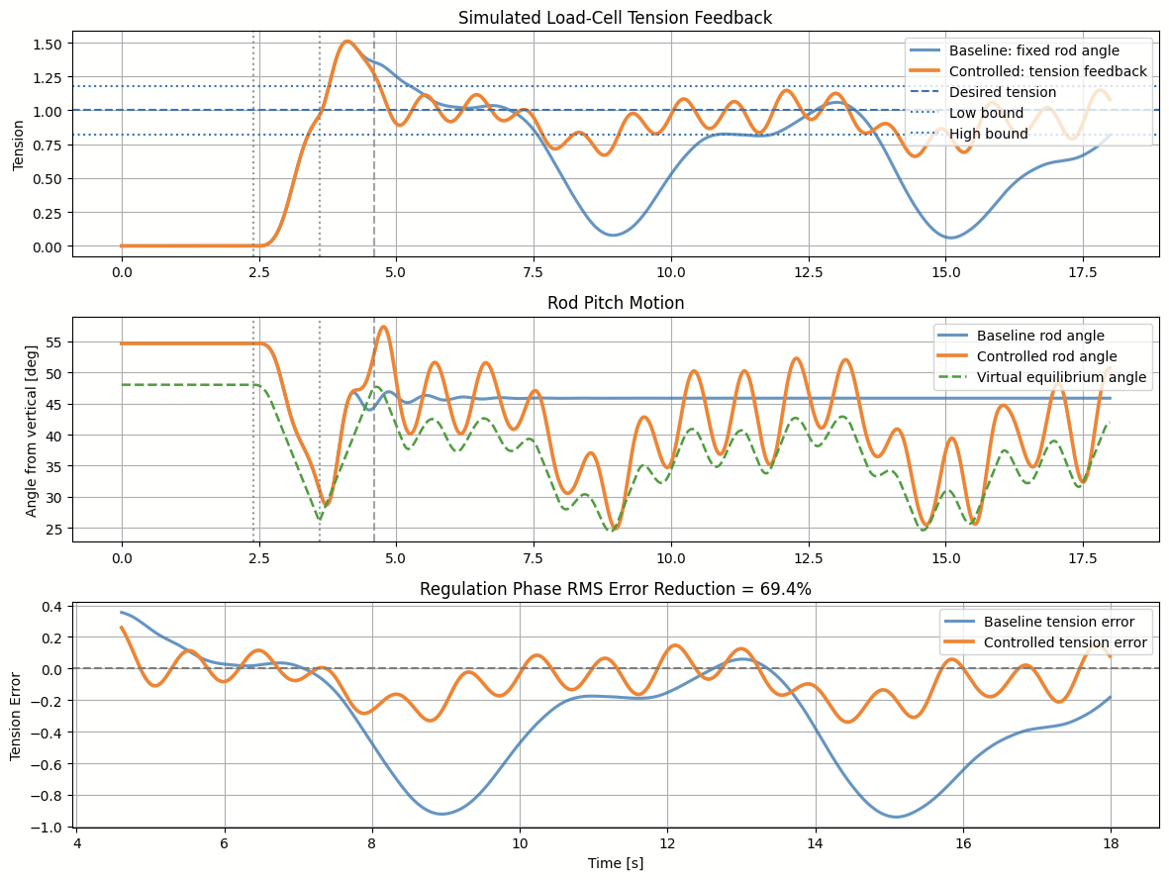
Controller Comparison
Admittance Control
Proportional Force Control

Slide 16
Results

Slide 17

Manual pulling creates line-tension changes, and the rod responds through the Dynamixel motor.

Slide 18
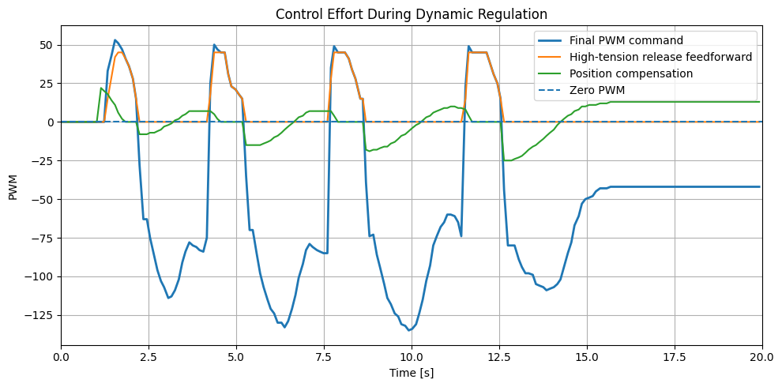
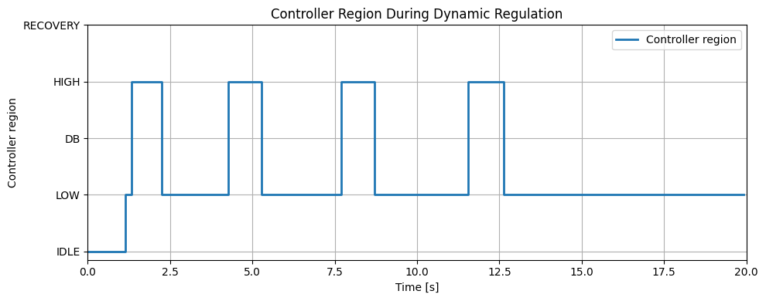
Dynamic Controller Response
Test condition: Rapid manual pulls were applied to create sudden line-tension changes.
Key result: the controller switched between release and pull-back actions, and the PWM command changed accordingly.

Slide 19
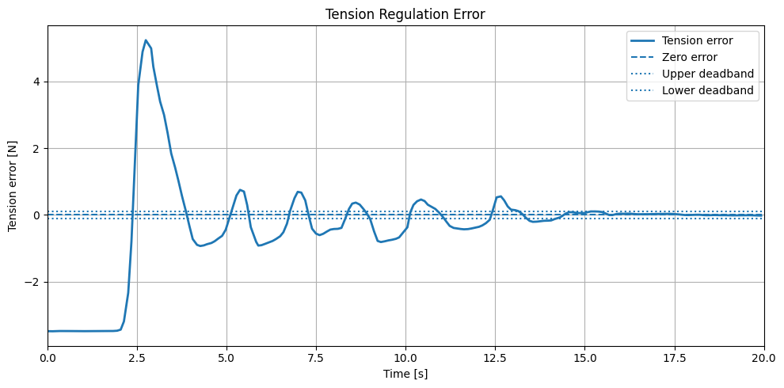
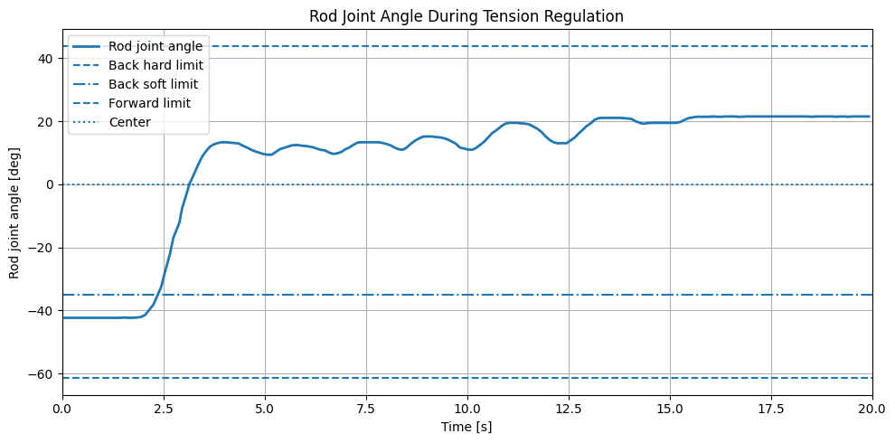
Post-Transient Regulation Accuracy
Test condition:
Initial manual pull followed by steady holding to evaluate whether the controller can return the tension near the 3.5 N target.
Takeaway:
After the initial engagement and correction phase, the controller reduced the tension error and maintained the measured tension close to the target
Target tension: 3.5 N
Final 5 s window:
Mean tension: 3.52 N
MAE: 0.025 N (0.72%)
RMSE: 0.036 N (1.03%)

Slide 20
Future Developments

Slide 21
In truth, the fishing problem is extremely control rich in my opinion
I will try to convey this nuance
Notes:
upon further understanding of the problem, it became clear that this apparently simple problem has incredibly deep and rich control ideas embedded within it

Slide 22
Algorithmic extensions
2D Tension control
Planarized fish movement adds sensing complexity
Our load sensor is 1D
instead of direct linear force/tension estimation relation, need to be aware of tension vector
use load sensor info and kinematic state (encoders) -> kinematic variation
OR
(use joint torque/position and load cell) -> sensor fusion, extended kalman filter
complicates control problem
nonlinear coupling dynamics
orthogonal subspaces (hybrid control)
Hybrid control?
Force Control (Admittance) along the axis of the fishing line to maintain perfect tension
Rigid Position Control in the perpendicular axes
Motivation: stiffness to reorient rod optimally, while allowing compliance on the force adaptive pulling axis
Notes:
for one if we consider the planarized case and consider our limited sensing framework, we need to employ sensor fusion techniques to ensure optimal tension estimation
on the control front, hybrid control may be optimal and worth testing to allow admittance in the tension management axis and stiffness in perpendicular axes

Slide 23
Algorithmic extensions
More robust state switching capability
Current Finite State machine uses force thresholding, which is very “chattery”
Solutions/Considerations:
Hysteresis (anisotropic force thresholds for entering and exiting a state) & Debouncing (time based thresholding/conditioning) to limit false/rapid triggering
Bumpless transfer
smoothing filters
transition states?
Tension break detection (rate of force change) and funnel synthesis (bound tracking error)
Drops into a safe, heavily damped recovery ‘funnel’ in case of line break preventing the robotic arm from violently whipping backward and breaking motors
funnel synthesis concept also useful for control regain
Admittance Control hardware implementation (gain scheduling)
Notes:
another crucial facet of the control problem is state switching capability
discrete states are embedded within the fishing problem
discrete control switching is incredibly control rich
transition from fish searching to hook set.
switching from having fish to losing tension.
how do we ensure stable control behavior within our discrete state switching
funnel synthesis to bound the control behavior

Slide 24
Algorithmic extensions
Noise reduction
Probabilistic state estimation (HMM, Bayesian filter)
[important in RL, partial observability/limited info scenarios]
Frequency and derivative of the force to distinguish between fake disturbances (boat rocking, snag on seaweed) or an actual fish
OR
Just use vision (unless there are partial observability concerns)
Notes:
another important facet is state switching capability
transition from fish searching to hook set.
switching from having fish to losing tension.
how do we ensure stable control behavior within our discrete state switching

Slide 25
Algorithmic extensions (AI)
Adaptive neural network
Augmentation of control loop with an adaptive neural network feedforward term that learns the stochastic frequency of the fish's pulling behavior, effectively predicting the required q_d before the tension error grows too large.
Sim-to-real: Using the simulation as an AI training tool to optimize fish tensioning behavior.
Direct RL: neural network
Layered RL: controller parameter tweaking
sim pipeline can also be used for adaptive control tuning without AI

Slide 26
Hardware Developments
Redundantly actuated serial joint
Emulate rod compliance with active control capability?
Macro-micro manipulator structure
heavy base joint handle low-frequency, high-amplitude positioning (like tracking boat's movement)
A smaller, redundantly actuated serial joint near the tip can be tuned with a much higher control loop frequency to handle high-frequency stochastic disturbances
inertial decoupling: torque efficiency, jerky movements doesn’t cause heavy base motor to respond
Null space optimization
infinite joint configs.
initiate secondary optimization objectives (torque minimization)
Dynamic impedance shaping
redundant motor acts as dynamically tunable physical stiffness unit that adheres to control needs

Slide 27
Hardware Developments
A compliant segment added to the end of the rod
tune stiffness characteristics
mechanical LPF, dealing with incredibly jerky fish motion in true fishing scenarios
bumpless transfer stabilization (state transitions), reduce risky torque spikes

Slide 28
Hardware testing rig
Actuatable object to mimic a fish that has planarized movement capabilities to perform varied experiments on our hardware system and its accompanying controller design

Slide 29
Practical Additions
Bringing the product to ‘market’
Tensioning reel mechanism
actuated hooking system

Slide 31
Sources
https://www.researchgate.net/publication/344142164_Haptic_Display_Using_Fishing_Rod

